Slide 1



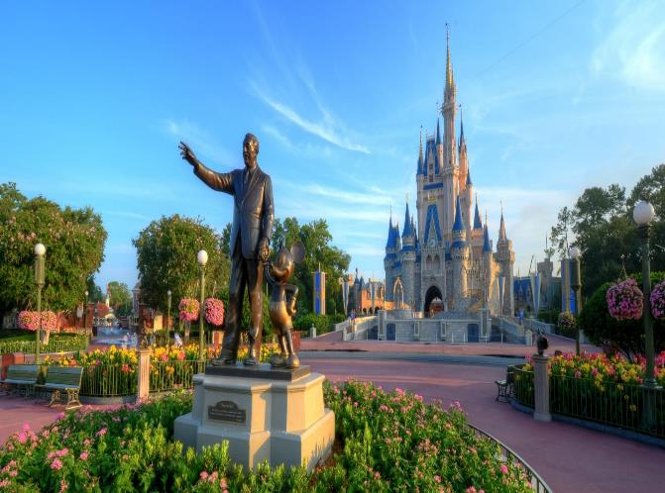
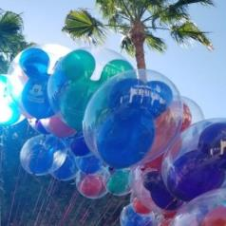

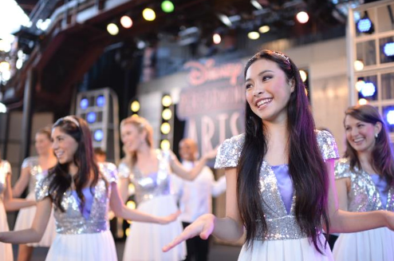
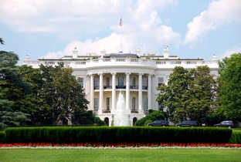
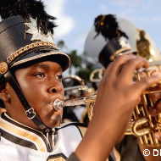



Lincoln High School
Band & Choir
2024 Walt Disney World/Universal Trip
Welcome!
Photos ©Disney

Slide 2
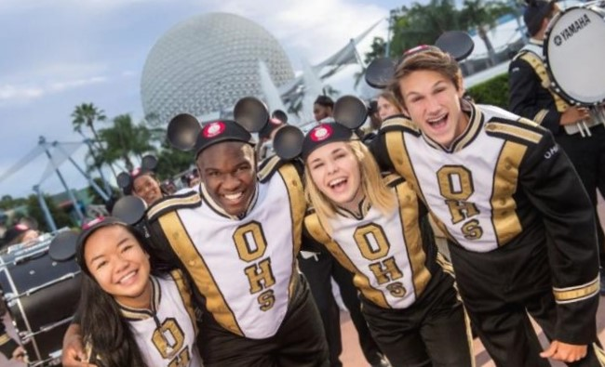
In This Meeting…
01
Our Trip and all that we’re going to see and do
02
What’s Included in our travel program
03
Our Travel Partner WorldStrides and why we are so excited to work with them
04
How to Sign Up for this incredible opportunity

Slide 3




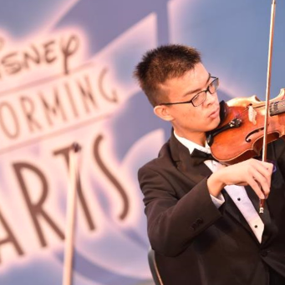
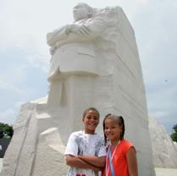
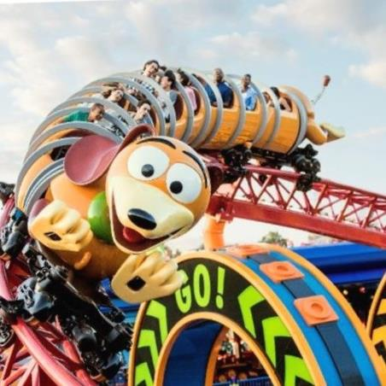
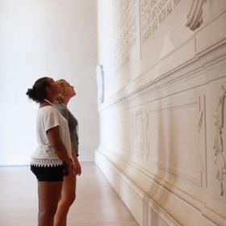
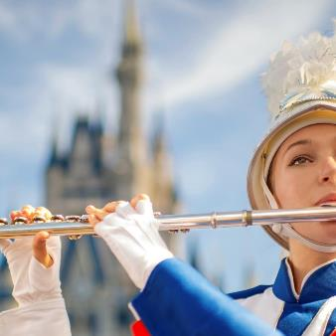
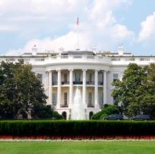

Our Trip Includes
Hotel Accommodations
Transportation to & from our destination, and throughout the trip
Meals
Attractions & Activities
Course Leader
Safety and Support
Now for the fun part…let’s look at everything we’re going to do and see!
Photos ©Disney

Slide 4
Our Trip Inclusions
Round trip airfare to Orlando
Full Time Course Leader throughout our stay in Orlando
Limited motor coach transportation as needed in Orlando (see itinerary for details)
Four Day Base Tickets to explore the theme parks of Walt Disney World, and 1 day/2 park Universal Orlando Resort/Islands of Adventure
Four nights in an Orlando area hotel
Overnight security guards each evening
Disney Performances for Band and Choir (pending acceptance)
Disney Workshops for Band and Choir (pending acceptance)
Hotel Breakfast Each Day
Meal Cards for use in the theme parks ($20 Day 1 and 5, $40 Days 2-4)

Slide 5
Traveling with WorldStrides
Over 50 years of planning and fulfilling amazing student tours.
Health & Accident Insurance for every traveler.
Over $50 million in General Liability Protection.
Full Time, Certified Course Leaders.
Overnight security guards in your hotel hallways each evening.
24 Hour Emergency Hotline support.
Trip Delay Protection Insurance included.
Doctors On Call service.

Slide 6


Slide 7
Our Trip Details
Trip Dates: January 20-25, 2024
Price: $1999 per student in QUAD occupancy (this price assumes 160 paying participants)
Deposit: $175
Our Registration Deadline is: June 16, 2023
Full Refund Program: This protection is $217. Full Refund Program (FRP) provides a full refund of all monies paid to WorldStrides (minus the cost of the FRP program) should you have to cancel for any reason.

Slide 8




Thank you for Attending!
Sign up today!
Your Tour Web Code is TLU4BKS
Online: https://spark.worldstrides.com
Phone: 877-545-0070
Questions? Email them to Schwegler@lincolnk12.org
We can’t wait to see you all in
Disney World!

Slide 9
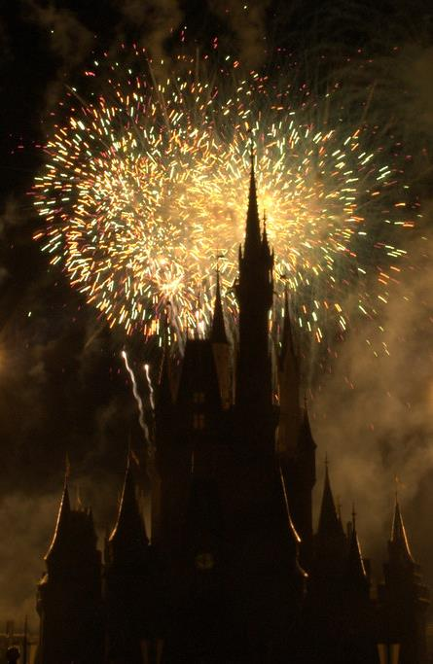
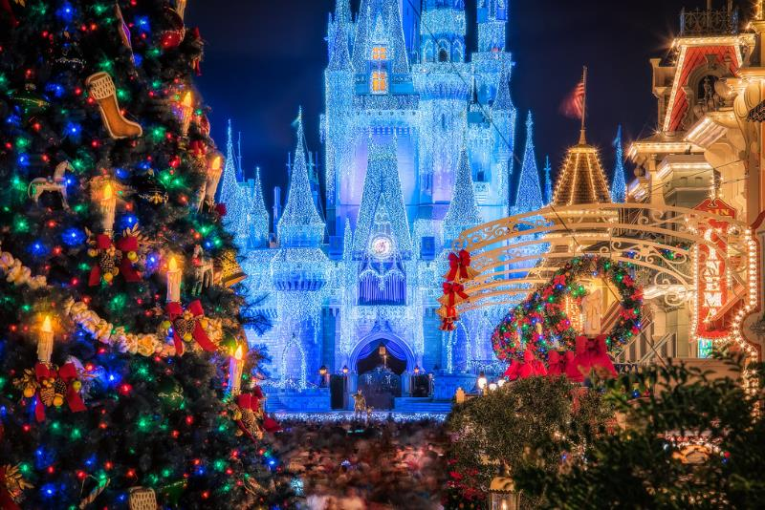
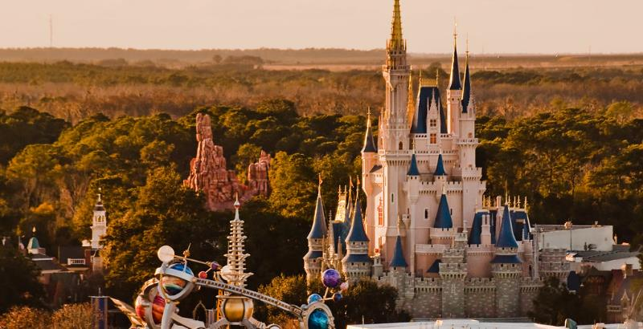
Questions about our trip or about traveling with WorldStrides
Photos ©Disney

